Slide 1
CS3247 Progress Report
Team 11: Membrance
Alex, Thang, Jason, Tian Fang, Zhu Bo, Edeline

Slide 2
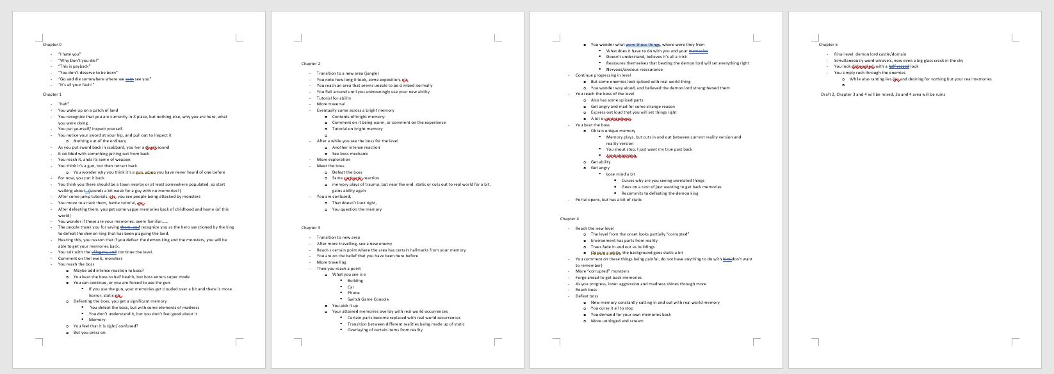
Story
Up to 5 chapters
Working with team on general monster outline

Slide 3
Basic Actions - High Priority (In Progress)
Actor | Type of Actions | Actions | Details/Implementation
Character | Basic/Movement | Walk/Run | - Press or hold A/D keys, move left and right - Press one time will move certain distance, - Hold will move distance according to the duration the key is being held
 |  | Jump | - Press space bar
 | Attack | Slash (Melee) | - Press right SHIFT key to attack one time - One attack will deal damage to enemy in front within a certain radius (semi-circle) - Drop any holded item e.g. shield - Animation (found some usable assets from asset store)

Slide 4
Basic Actions - High Priority (In Progress)
Actor | Type of Actions | Actions | Details/Implementation
Enemy Type 1 | Basic/Movement | Idle/Alert | - Create a collision sphere/box, when the character is not within the range, monster will be in idle mode e.g. just move around randomly - When character enters the collision region, enemy will change to alert mode whereby ready/will attack
 |  | Travel | - Idle: Randomly move left and right, can set using a random generator - Alert: Walk towards a bounding volume in front of character
 | Attack | Melee Attack | - Deal damage to character in front of the enemy - Show number (e.g. -10 health) - Animation (still searching for assets from asset store)

Slide 5
Basic Actions - Lower Priority
Actor | Type of Actions | Actions | Details/Implementation
Character | Basic/Movement | Pickup | - Press E key to pick up item, use it immediately if it’s usable item e.g. potion, if not will follow ‘Throw Objects (Surrounding)’
 |  | Dash/ Dodge | - Press X key to evade (one time)
 | Attack | Throw Objects (Surrounding) | - Press E key to pick up items (raise above the character or just hold in front) - Press the same key again to throw it in front, follow a projectile with a fixed distance
 | Ability | Slow Motion | - Press Q key to start slow motion - For slow motion, decrease the rate/distance that the enemy can move or use perform any actions, need to adjust the damage items/elements projected from the enemy accordingly

Slide 6
Basic Actions - Lower Priority
Actor | Type of Actions | Actions | Details/Implementation
Enemy Type 1 | Attack | Distant Attack | - Damage items (arrows, stones etc.) will follow a projectile movement, can either project in a straight line or in a curve line - Attacks can set a max. attack distance, the attack will be auto destroyed after exceeding the max. distance
 | Skills | Bleeding/ Poisoning | - Can create some poison patch on the floor, stepping on these patch will decrease certain amount of HP per second - Launch some attack, if character get hit, will decrease HP overtime for a certain period of time
 |  | Movement Restriction | - Launch some attack, if character get hit, become immobile for a certain period of time
 |  | Capturing Hostage | - Hold the hostage in front, will switch left and right at fixed time interval - If too close with character, will face the character, need to set sight range for the enemy

Slide 7
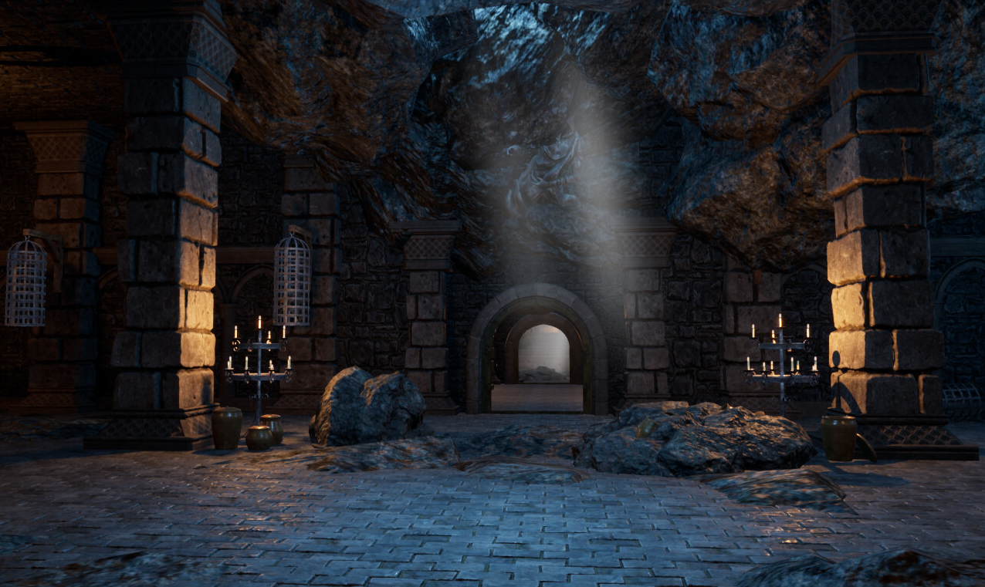
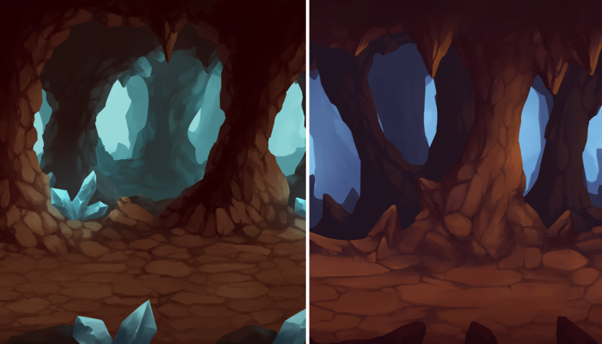
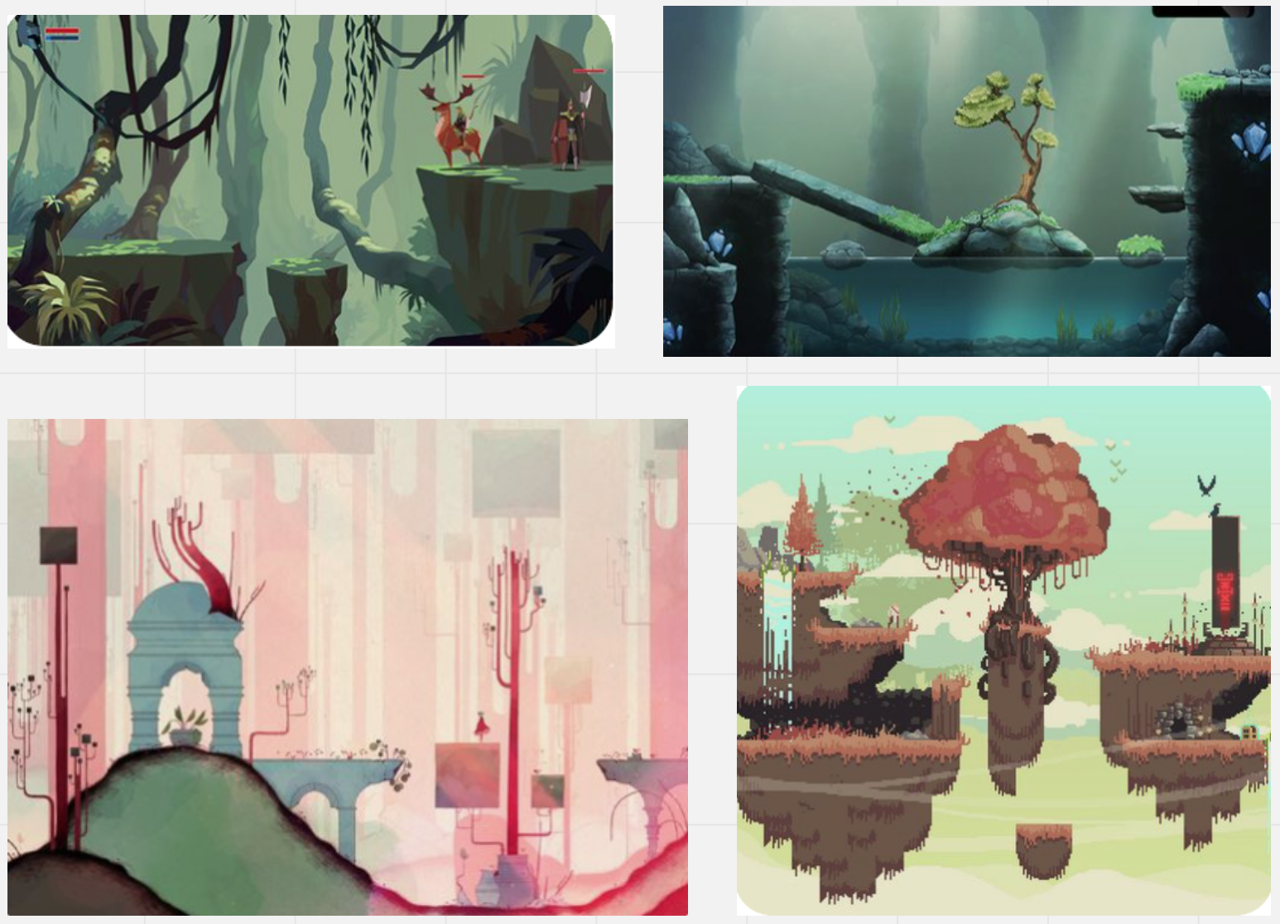
Level Design: Concept
References for general setting vibe:
Setting
First phase: Dungeon/Cavern/Ruins
Second phase: Jungle/Forest
Third phase: Castle
Follow story progression
Idealized imaginary world, slowly become corrupted

Slide 8
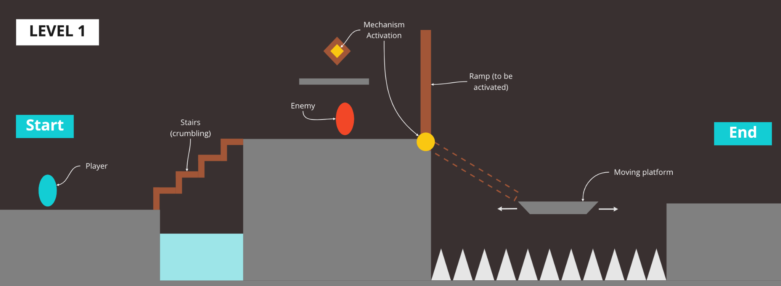
Level Design: Map (Skeleton)
Level 1: Teach the basic mechanisms that will be used again in future levels

Slide 9
Level Design: Core Mechanisms
Crumbling stairs
Mechanism-activated ramp
Moving platforms

Slide 10
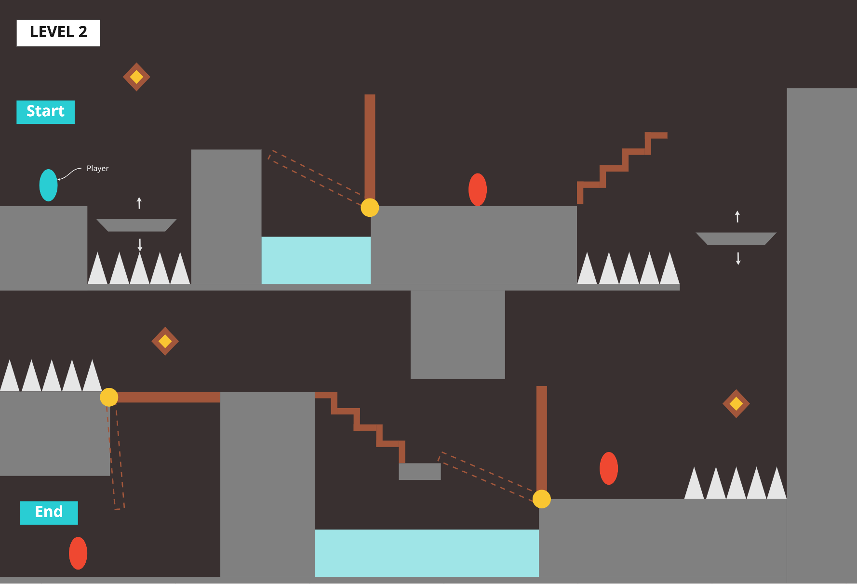
Level 2: Practice existing mechanisms & teach boss fight

Slide 11
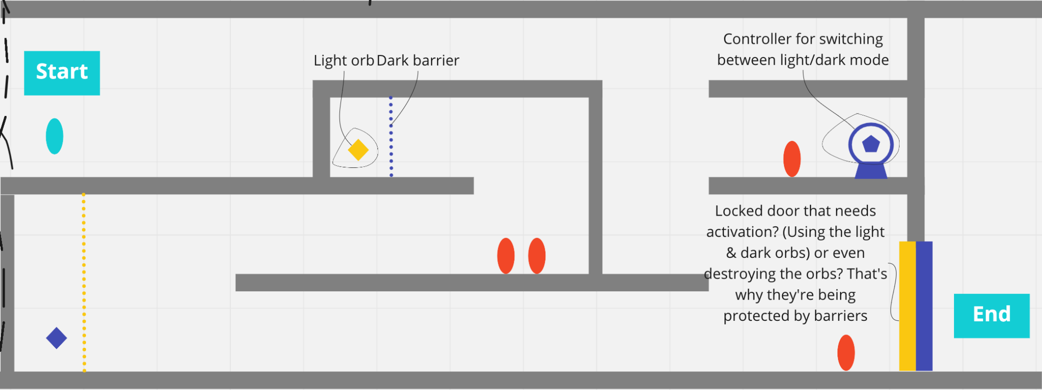
Future extension to mechanisms: Light & dark barrier deactivation
Players get to use existing knowledge on mechanisms (colour coded)
Tie back to the theme of conflicting opposite forces
Perception, duality, overcoming, conflicting, balance

Slide 12
Thank you!

